Slide 1

Case Study Data Science Exercise Customer Churn
Ashit Debdas
[06/27/2022]

Slide 2
Agenda
Customer Churn
Background / Business Problem 3
Analysis – Data Set Characteristics 4
Key Takeaways – Hypothesis Building 5
Analysis – EDA 6-10
Analysis – Cleaning & Pre-processing 11
Analysis – Modelling, Tuning & Evaluation 12
Analysis – Key Evaluation 13
Next Steps & Improvements 14
Appendix 15

Slide 3
Background / Business Problem Customer Churn
Avoid contract terminations (churn) to increase their revenue base and predict behavior to retain customers.
Situation
Customers in the telecom industry can choose from a variety of service providers and actively switch from one to the next. The telecommunications business has an annual churn rate of 15-25 percent in this highly competitive market.
Looking at churn, different reasons trigger customers to terminate their contracts, for example better price offers, more interesting packages, bad service experiences or change of customers personal situations.
Individualized customer retention is tough because most firms have a large number of customers and can't afford to devote much time to each of them.
Business Action
This study we will analyst those feature which associate with customer churn. This will help us make the right business decision to build customer loyalty and win new customers as well.
To accomplish the main challenge is to predict whether an individual customer will churn or not we have formed an automatic learning model. It will help companies reduce their costs and their workforce.

Slide 4
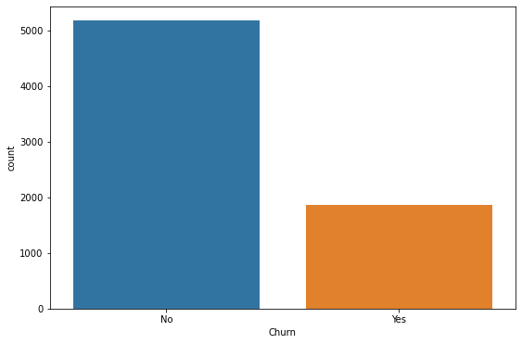
Data Set Characteristics Telecom Customer Churn
Dataset Information
Dataset Visualizations
Basic characteristic about dataset
Shape – 21 features with 7043 recodes
Features – we have 21 feature including labels. The features can also be clustered into different categories:
1. Labels - Churn
2. Customer services booked - Example (InternetService, OnlineSecurity, StreamingTV, Tech Support, Phone Service )
3. Customer account information - Example (Tenure, Contract, PaymentMethod)
4. Customers demographic info – Example (customerID, Gender, SeniorCitizen, MonthlyCharges )
Missing values - TotalCharges feature has 11 missing value which is 0.16%
Duplicates – There is duplicate records.
Observations – we observed the class imbalance of the data between churners and non-churners.
Class Imbalance

Slide 5
Key Takeaways
Hypothesis Building
Tenure, contract duration terms and number of additional services are assumed to be among the most important drivers of churn.
Monthly payment - More expensive contracts lead to increased churn as the chances to save money by changing providers might be higher.
The longer the contract duration the less likely it is that the customer will churn as he/she is less frequently confronted with the termination decision and potentially values contracts with reduced effort.
Dependents - customers with spouses and children might churn less to keep the services running for their family.
Customer services booked - customers are willing to cancel simple contracts with few associated product components quicker and more often than complexed product bundles — for bundles customers value the reduced administrative complexity.

Slide 6
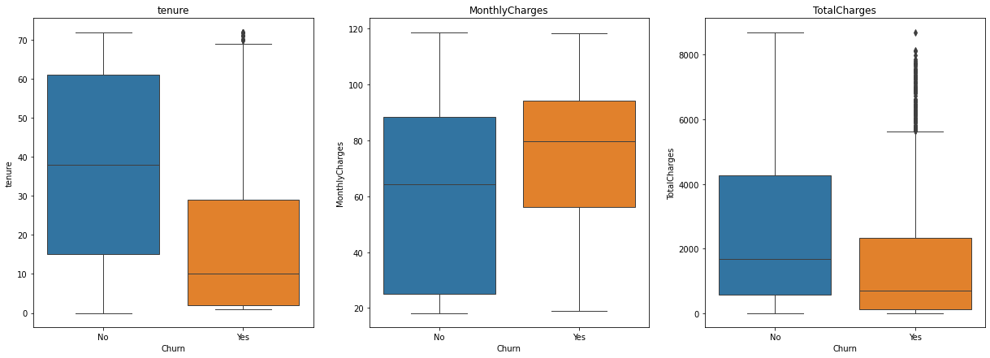
EDA – Exploratory Data Analysis Customer Churn
Visualization EDA 1
Churning customers have much lower tenure with a median of 10 months compared to a median of non-churners of 38 months.
Churning customers have higher monthly charges with a median of 80 USD and much lower interquartile range compared to that of non-churners median of 65 USD.
TotalCharges are the result of tenure and MonthlyCharges, which are more insightful on an individual basis.

Slide 7
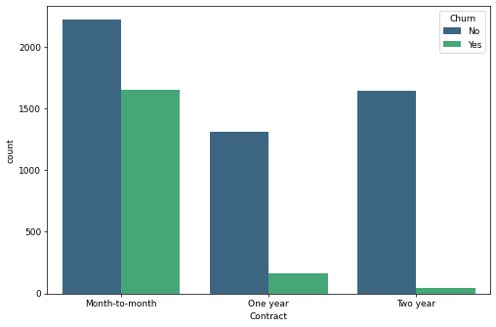
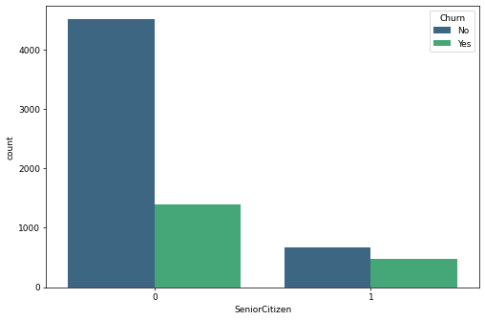
EDA – Exploratory Data Analysis Customer Churn
Visualization EDA 2
Visualization EDA 3
Contract - churn rate for month-to-month contracts much higher that for other contract durations
Senior citizens churn rate is much higher than non-senior churn rate.

Slide 8
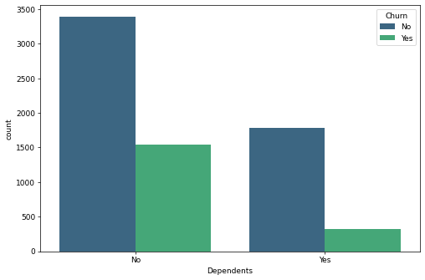
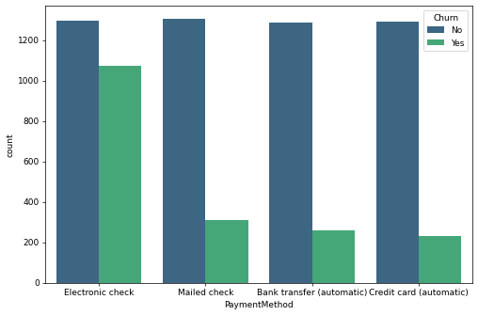
EDA – Exploratory Data Analysis Customer Churn
Visualization EDA 4
Visualization EDA 5
Much higher churn rate for customers without children
Payment method electronic check shows much higher churn rate than other payment methods

Slide 9
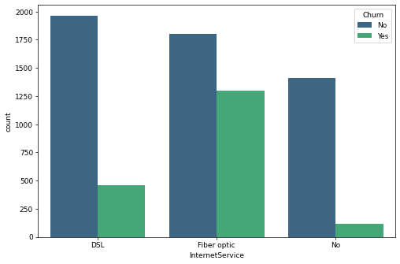
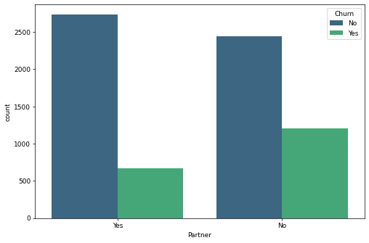
EDA – Exploratory Data Analysis Customer Churn
Visualization EDA 6
Visualization EDA 7
Customers with InternetService fiber optic as part of their contract have much higher churn rate
Moderately higher churn rate for customers without partners

Slide 10
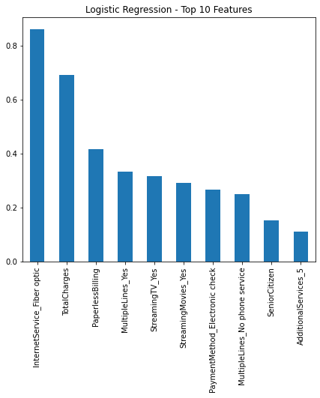
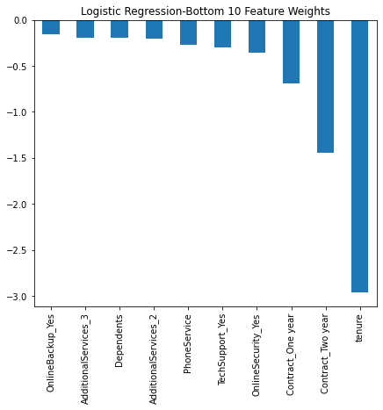
EDA – Exploratory Data Analysis Customer Churn
Visualization EDA 6
Visualization EDA 7

Slide 11
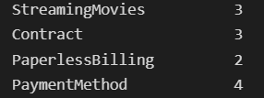
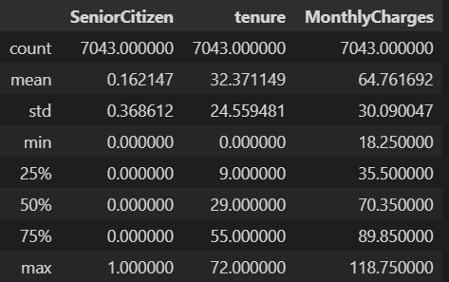
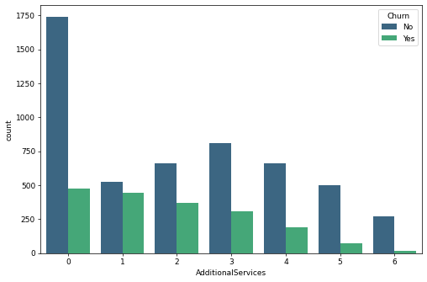
Data Cleansing & Pre-processing Customer Churn
Categorical Features
There are majority of the feature are categorical in nature some of the has two values Example- Yes / No. and few of them has more the two values.
Numerical Features
There are few numeric feature Example – Senior Citizen, tenure and Monthly Charges .
Feature Engineering
There are a lot of feature comes under customer service booked. Example: Online Security, Device Protection, Streaming Movies, Tech Support, Streaming TV, Online Backup etc.
Build a new feature called Additional Services, which shows that customers with a very high number of additional services do have a low churn rate.

Slide 12
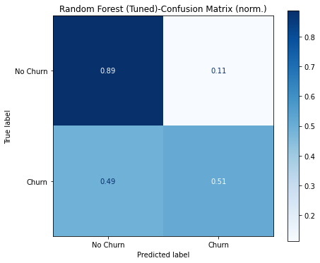
Modelling, Tuning & Evaluation Customer Churn
Model Selection
Model Evaluation
I performed Logistic Regression, Decision Tree and Random Forest. Where Logistic Regression accuracy score was 0.80 and F1 score was 0.58.
Hyper parameter tuning - In order to optimize the performance of each mode I used GridSearchCV, RandomizedSearchCV
After optimized out this three model Random forest has performed well where:
Accuracy Score Test: 0.79
Accuracy score Train: 0.87
AUC Score: 0.84
F1 Score: 0.55
Confusion Matrix
Churn (TPR) – 0.51%
No churn (TNR) - 0.89%
Actually churn but predicated as a no churn (FNR) – 0.49%
Actually no churn predicated as a churn (FPR) – 0.11%
This matrix shows us no churn class can classify correctly 89% and churn class only 49% classify correctly.
Confusion Matrix Actual Numbers
Churn (TP) – 182
No churn (TN) - 932
Actually churn but predicated as a no churn (FN) – 175
Actually no churn predicated as a churn (FP) – 118

Slide 13
Key Evaluation
Hypothesis Evaluating
Looking at the evaluation results, specifically the feature weights from the logistic regression, the hypotheses can be directionally supported or refused:
Tenure: High tenure ranks as the strongest factor for not churning and the strongest feature overall. This is also supported by the boxplot in the EDA step. → supported.
Monthly payment: Total payments, which is the product of tenure and monthly payment ranks as the strongest factor for churn. Indirectly, high monthly payments lead to churn. However, tenure is the highest driver of not churning → partially supported.
Contract duration: Contract duration month-to-month is driver of churn → supported.
Partners and children: Having children ranks as the last 3rd feature that drives not churning, but strength is relatively low → refused.
Number of additional services: This feature does rank among the top features → supported.

Slide 14
Next Steps & Improvements Customer Churn
Area of Improvement
Since class was imbalance we can used following
Resample ( Up-sampling)
Using Boosting algorithm
Experiment with another data science algorithm Like
- Neural Network Algorithms
- Xgboost
- LightGBM

Slide 15









Development Environment
Python
Libraries: Scikit-Learn, Pandas, NumPy etc.
Code
Windows
Anaconda
VS Code
Environment
Seaborn
matplotlib
Visualization
CSV
Data

Slide 16
Thank you

